Slide 1

Rhythm Framework
By: Joao Marcus Dionisio
Thiago Cortez

Slide 2

Summary
Getting Started
......................................................................................................... 02
Preparing The Music Editor
......................................................................................................... 04
Mapping Your First Music
......................................................................................................... 06
Finishing And Saving Your Music Map
......................................................................................................... 08
Setting and Calling Events in Your Game
......................................................................................................... 10
Playing Your Music
......................................................................................................... 14
Setting Time Offset
......................................................................................................... 15
01

Slide 3
Getting Started
Rhythm Framework is a powerful and simple tool that will increase the speed of your Rhythm Based Game development.
The framework has an editor, who uses informations of your music, as music lenght and music bpm to create an map of beats who will be used in your game for event driven actions call.
02

Slide 4
Getting Started
This document will help you to use the framework properly. The following pages contains instructions about the tool.
This asset contains:
All source code
An scene that will be your editor
An mini game as example
An mapped music (Vaporwave)
03

Slide 5
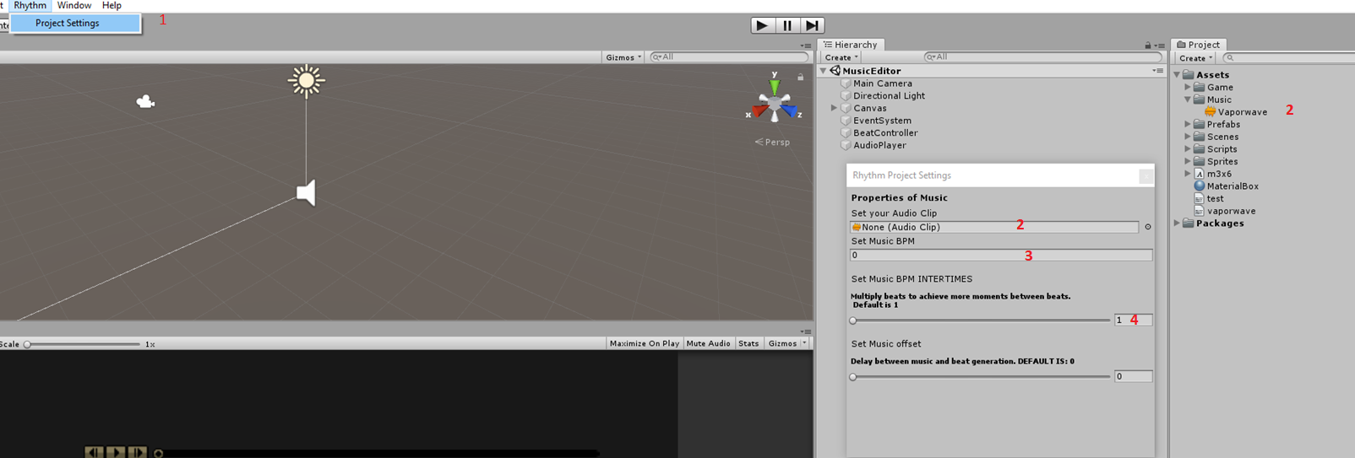
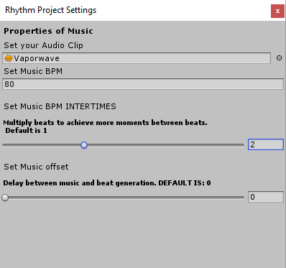
Preparing The Music Editor
Open Rhythm Window Settings: top menu Rhythm > Project Settings
Set your AudioClip
Set Music Bpm Field. You have to know the Bpm of your music
Set times between beats generated (Min 1 Max 4), More times = More beats generated for your map
My settings for example music:
04

Slide 6
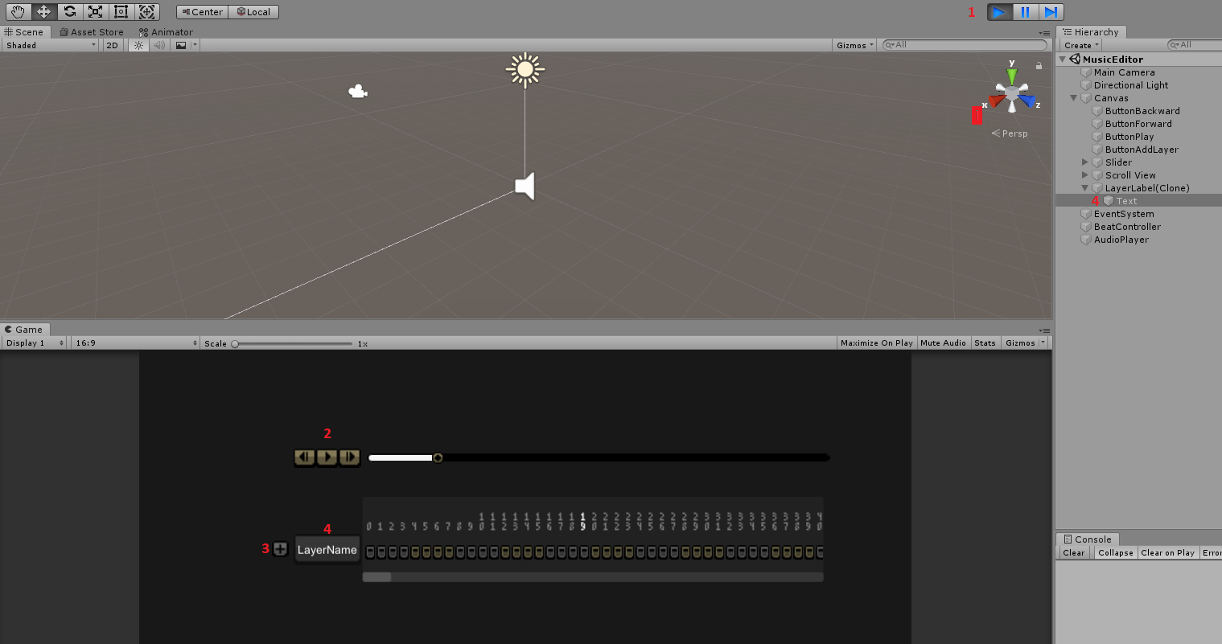
Preparing The Music Editor
Press Play in Unity Editor
Press Play in Rhythm Editor Music Player. You can Backward and Forward your music
Click + to add your first layer
Set layer name
05

Slide 7
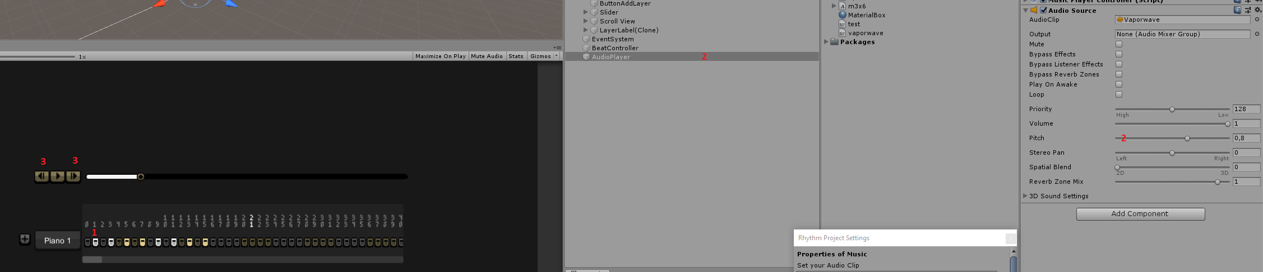
Mapping Your First Music
Select Piano 1 beats. You can use scrollwheel of your mouse to scroll the timeline.
If music is going to fast, you can set speed in AudioPlayer Object, in AudioSource > Pitch
You can forward and Backward music any time
Shortcut Keys for: Backward is Q, Play/pause is W, Forward is E
06

Slide 8
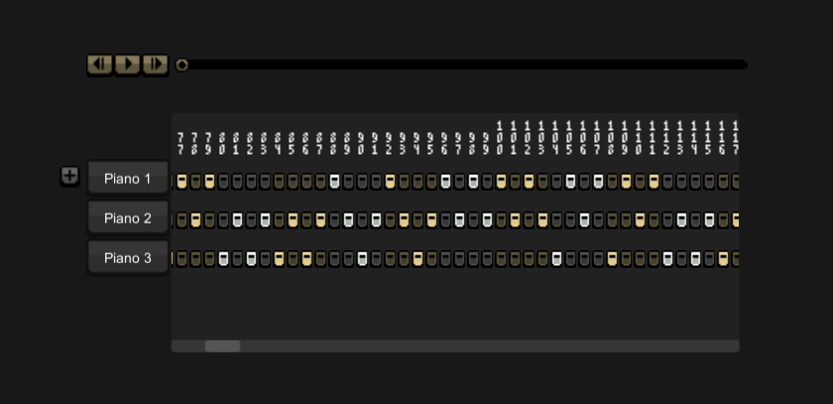
Mapping Your First Music
Add new layers
Select more beats
Each selected beat represents an event in your game
07

Slide 9
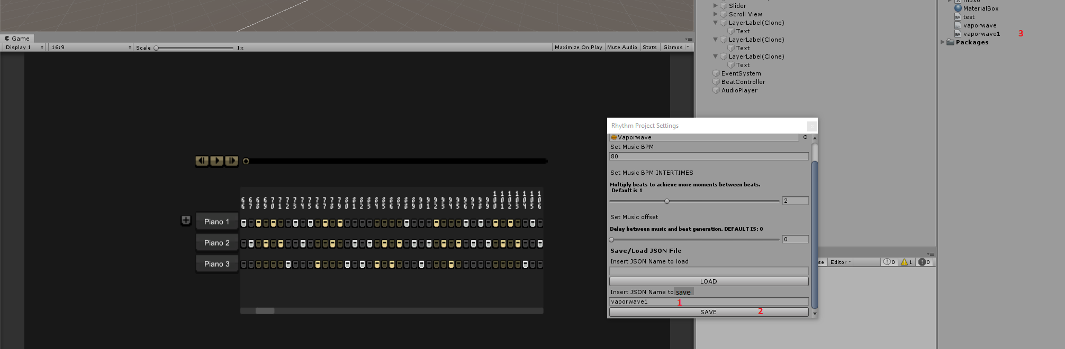
Finishing and Saving Your Music Map
In Play Mode, go back to Rhythm Project Window and Set a Name to Save
Click in Save Button and Exit Play Mode
Your JSON file will be created in root of Assets folder
You must remember your Layer Quantity, for future modifications on your map. In this example we have three
08

Slide 10
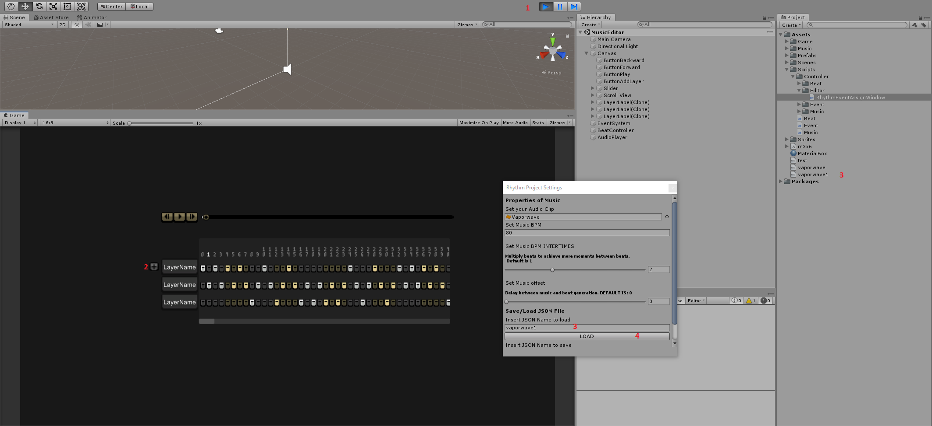
Finishing and Saving Your Music Map
TO EDIT YOUR SONG: Enter in Play Mode and Press Play in Rhythm Music Player
Before we create 3 Layers, so we have to click in + three times, to create three layers
Set the name of JSON file we had created before
Press Load. Edit and Repeat save routine
09

Slide 11
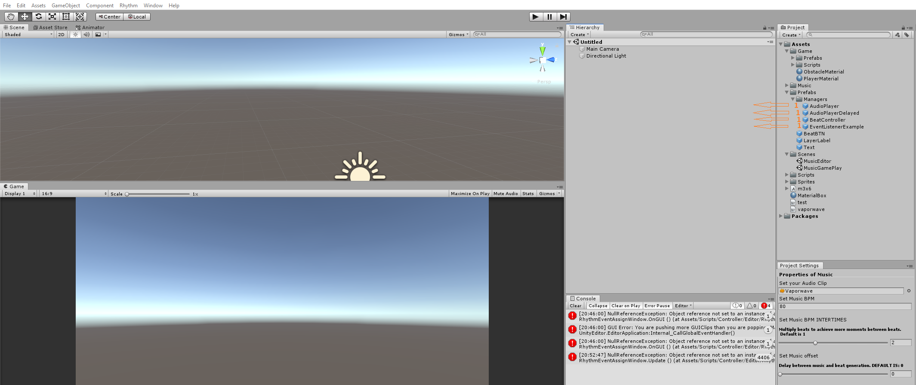
Setting and Calling Events in Your Game
Create a new scene and go to: Prefabs > Managers. Drag to scene: AudioPlayer, AudioPlayerDelayed, BeatController and EventListenerExample.
10

Slide 12
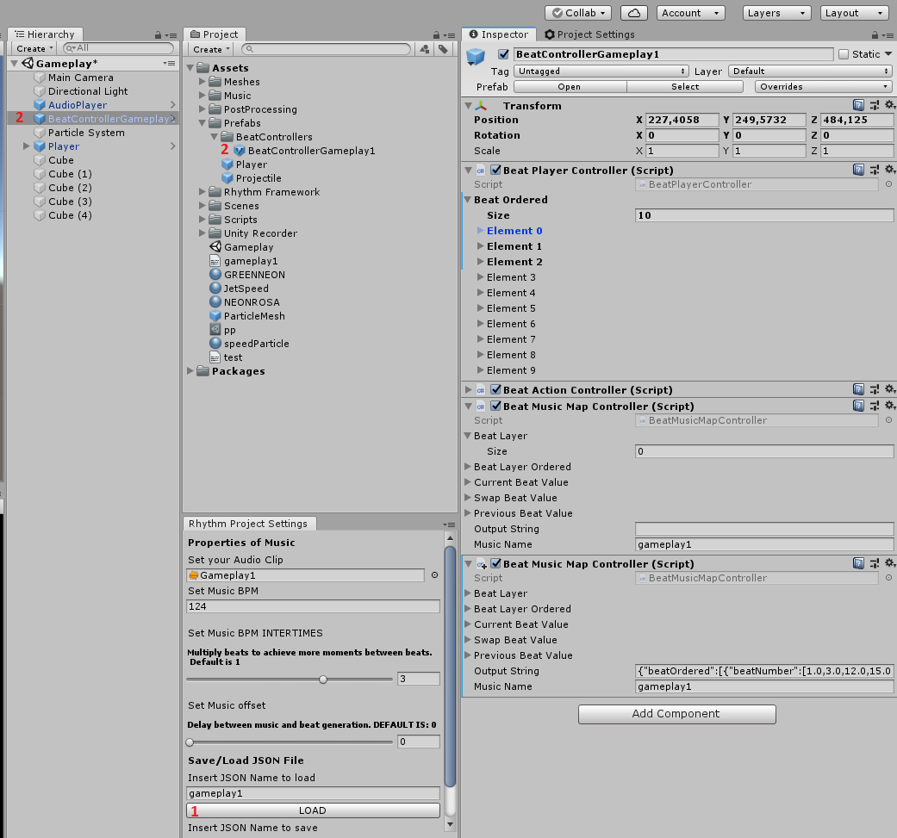
Setting and Calling Events in Your Game
To load a music, write her JSON respective name and click LOAD
For each music save an BeatController prefab variant
IMPORTANT: If you want to load again the same music,
rename the beatcontroller in your scene to BeatController
and clicl load
11

Slide 13
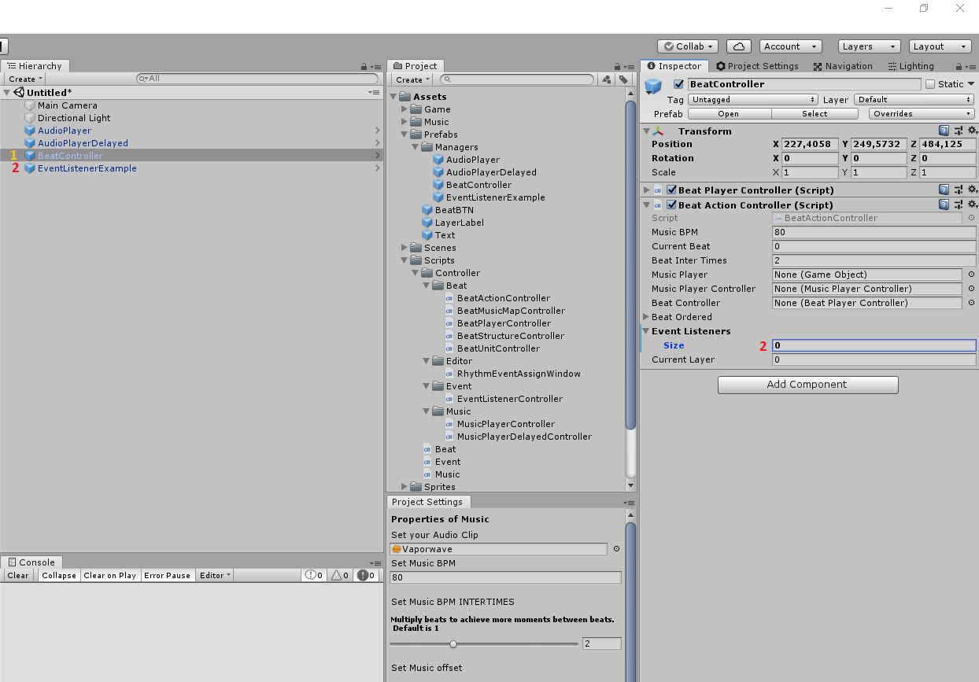
Setting and Calling Events in Your Game
Select BeatController in Hierarchy Tab
DragEventListenerExample into Event Listeners Array
12

Slide 14
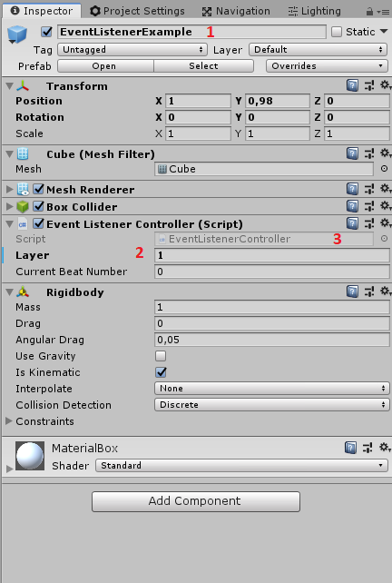
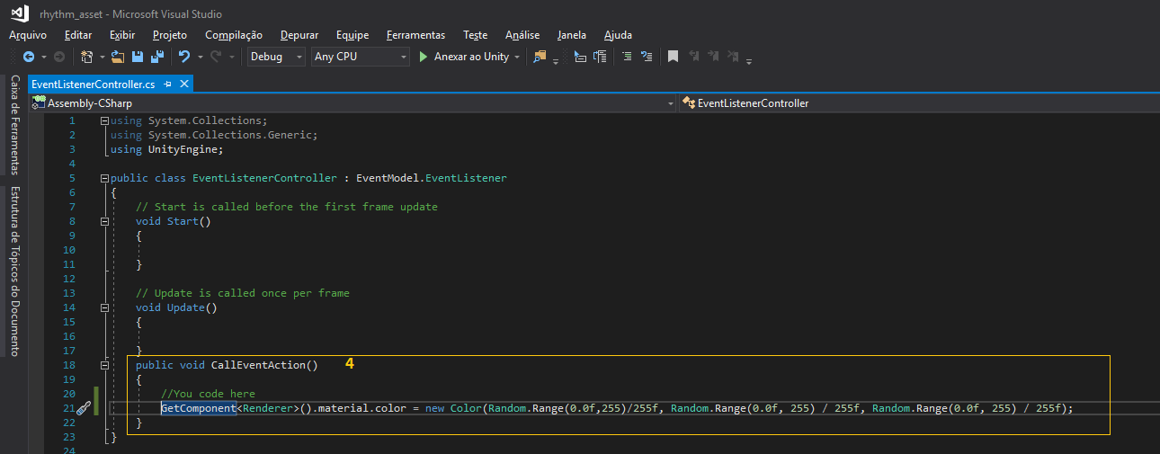
Setting and Calling Events in Your Game
Select EventListenerExample
On Script Component Event Listener Controller, set the layer number that your object will listen
Double-Click on Script
Code your actions in CallEventAction() – In this example, I’ll set random color for each event
13

Slide 15
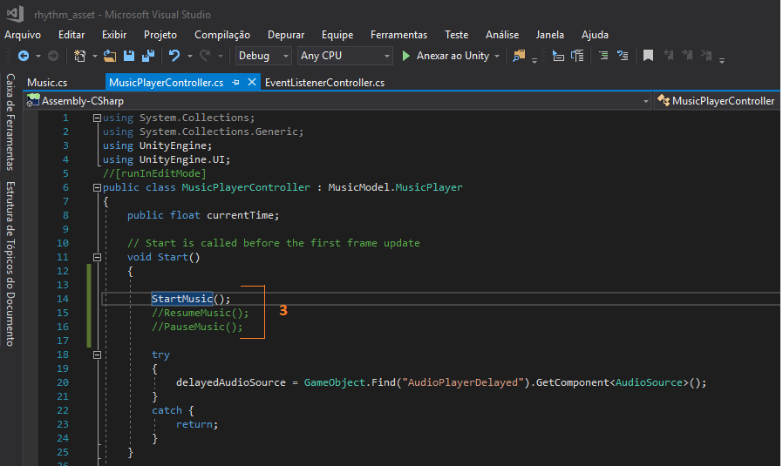
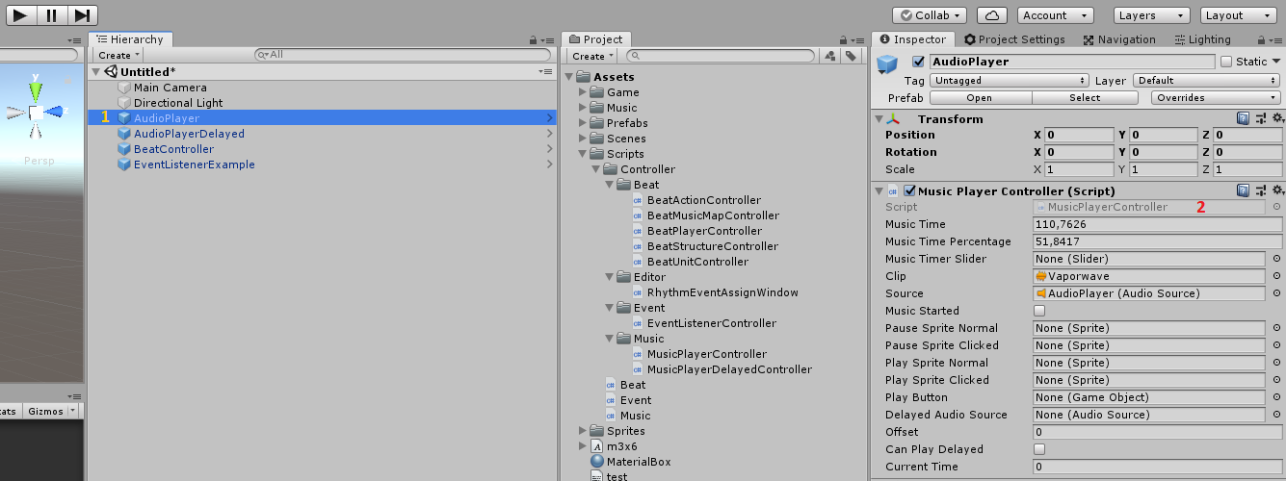
Playing your music
Select AudioPlayer
DoubleClick in Script Shortcut for MusicPlayerController.cs
You can StartMusic(), ResumeMusic() or PauseMusic() on this script.
You can call this methods from a Button, or another scripts using GameObject.Find(“AudioPlayer”).Getcomponent<MusicPlayerController>();
14

Slide 16
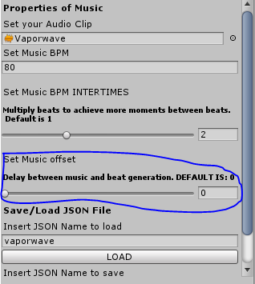
Setting Time Offset
You can set na offset in second if you want a delay between music and event generation
15

